Slide 1
Mini project 1: HDB
Presenter: Yap Yeong Cherng
Notes:
Dataset: HDB_Resale_prices 2017-2021aug
Kaggle: https://www.kaggle.com/laifookfatt/hdb-resale-prices-20172021aug/version/1?select=resale-flat-prices-based-on-registration-date-from-jan-2017-onwards.csv

Slide 2
Questions
Does HDB resale price follow an increasing trend ?
Can we predict this trend ?
resale value 5-10 years later ?
Dataset: HDB_Resale_prices 2017-2021aug
Kaggle: https://www.kaggle.com/laifookfatt/hdb-resale-prices-20172021aug/version/1?select=resale-flat-prices-based-on-registration-date-from-jan-2017-onwards.csv

Slide 3
Rm types selection
Initial data
3rm types:
'New Generation', 'Improved', 'Simplified', 'Model A', 'Standard’, 'Premium Apartment', 'DBSS', 'Terrace’
4rm types:
'New Generation', 'DBSS', 'Simplified', 'Improved', 'Model A’, 'Premium Apartment', 'Standard', 'Type S1', 'Model A2’, 'Adjoined flat', 'Terrace', 'Premium Apartment Loft’
5rm types:
Standard', 'Improved', 'DBSS', 'Adjoined flat', 'Model A’, 'Premium Apartment', 'Model A-Maisonette', 'Type S2’, 'Improved-Maisonette', 'Premium Apartment Loft'
Filtered data
3rm types:
'New Generation', 'Improved', 'Simplified', 'Model A', 'Standard’
4rm types:
'New Generation', 'Simplified', 'Improved', 'Model A, 'Standard', 'Model A2’, 'Adjoined flat’,
5rm types:
Standard', 'Improved, 'Adjoined flat', 'Model A’, 'Model A-Maisonette', 'Improved-Maisonette',

Slide 4
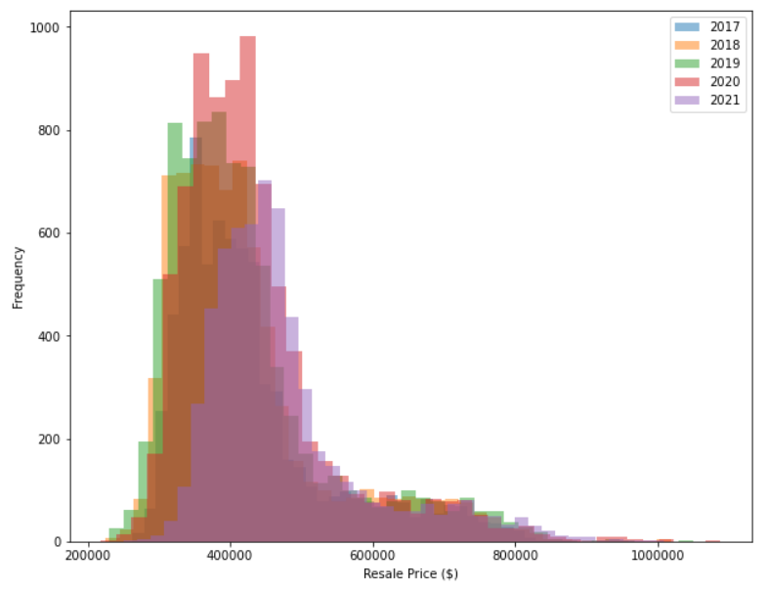
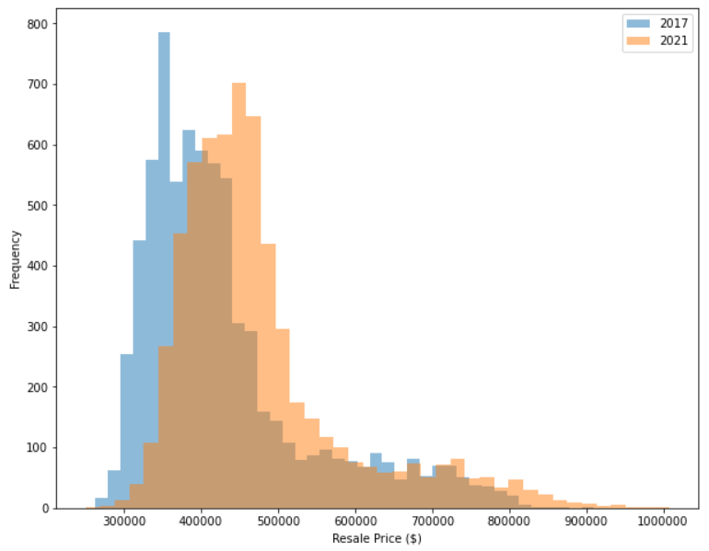
Histogram Plot by year (4rm data)
Right Skewed Distribution
Median shift from 2017 to 2019

Slide 5
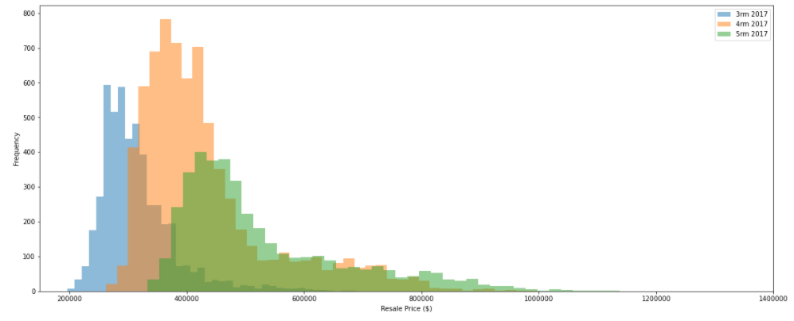
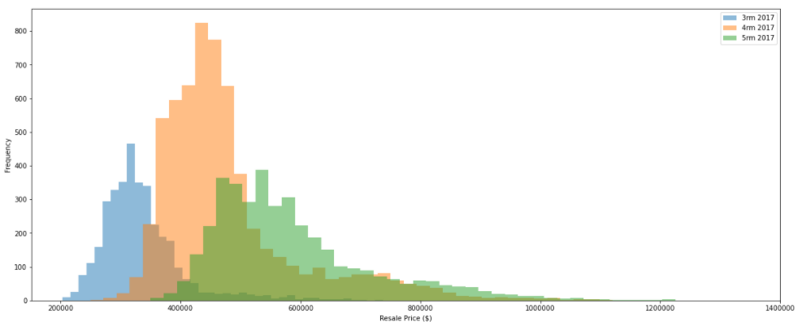
2017 vs 2021
2017 - 3rm vs 4rm vs 5rm
Median resale price
3rm: $300000
4rm: $400000
5rm: $479000
2021 - 3rm vs 4rm vs 5rm
Median resale price
3rm: $320000 (6.7% increase)
4rm: $450000 (12.5% increase)
5rm: $550000 (14.8% increase)

Slide 6
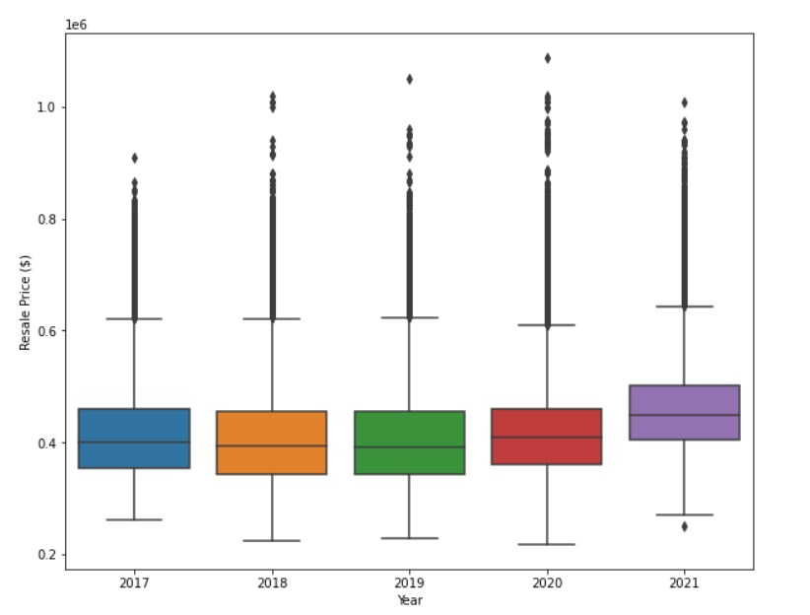
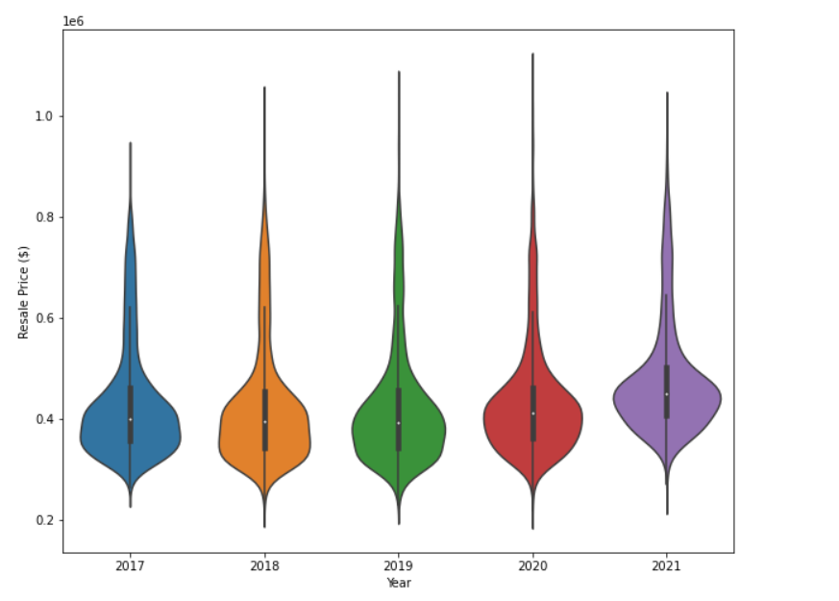
Box and violin plot
Resale price data vs Year

Slide 7
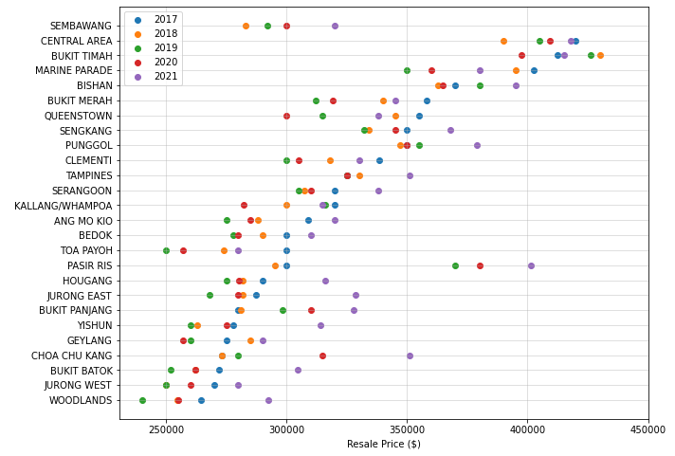
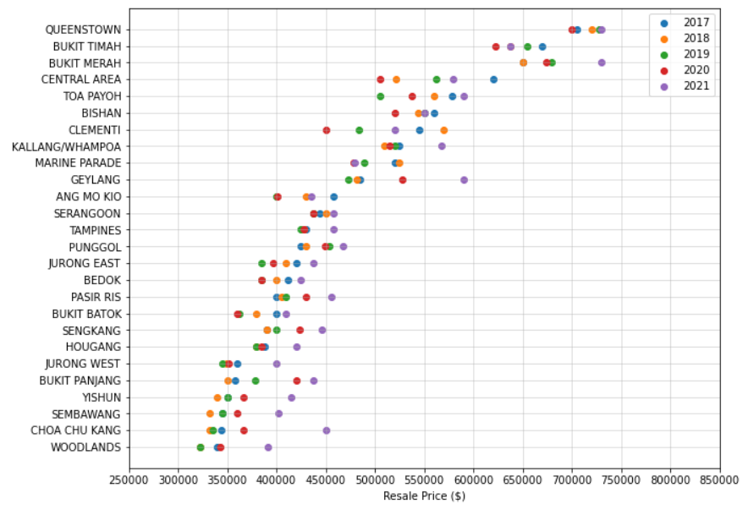
Scatter plotting
Town vs median resale price (3rm data) 2017-2021
Town vs median resale price (4rm data) 2017-2021

Slide 8
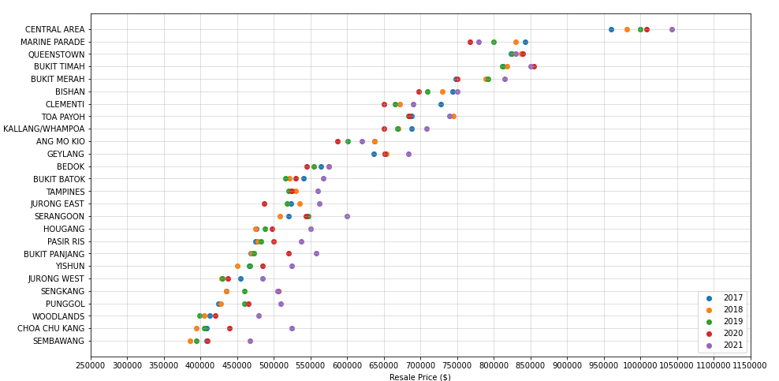
Scatter plotting
Town vs median resale price (5rm data) 2017-2021

Slide 9
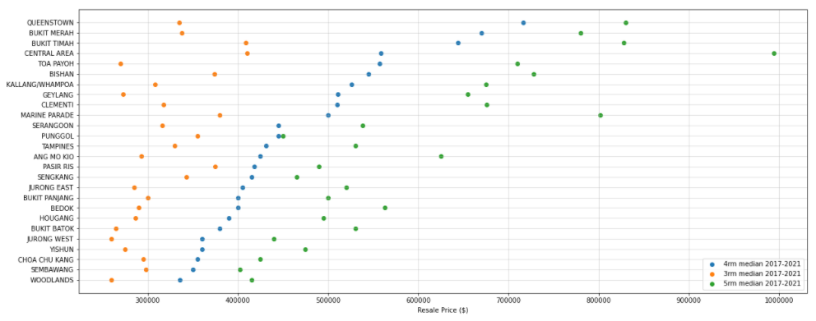
Data graphing
Location vs median resale price (2017-2021)
comparison between 3rm vs 4rm vs 5rm

Slide 10
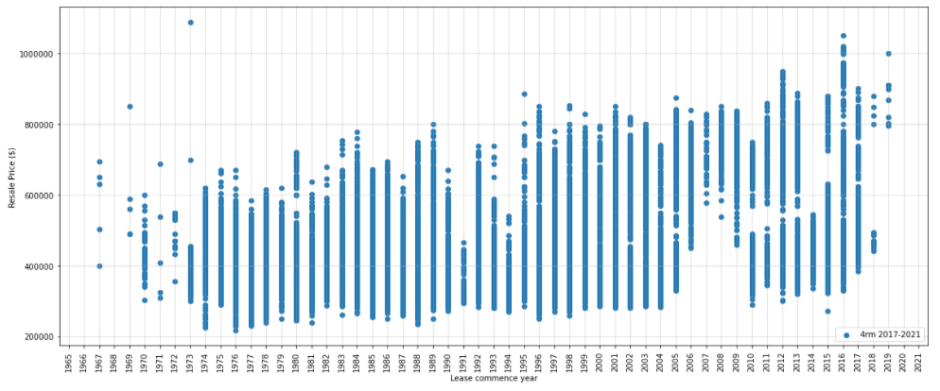
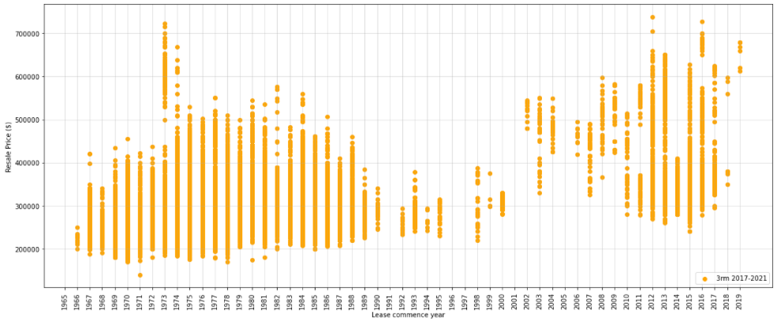
4rm and 3rm
Resale Price vs Lease commence year
Increasing trend

Slide 11
What’s needed next ?
More EDA against other parameters
Floor level
Size of unit (Sqm)
Remaining lease date
More data
Add more years before 2017
Previous occupancy years of stay
HDB Valuation
Loan interest rates
Amenities (ex. supermarkets, transportation, schools)
Incidents throughout the years (ex. recession, cooling measures, covid)

Slide 12
Q&A

